Slide 2
Your name here
City, State
Certified WebCenter Trainer
Occupation
Current UnFranchise Owner Level: * UFO level – refer to the associated commissions scale
List of achievements as a UFO

Slide 3
WEBSOLUTIONS PROVIDES A SYSTEM TO
Generate cash flow NOW!
Build a successful UNFRANCHISE

Slide 4
The Product & Service Is this a product/service that I like and is there a market for it?
Profitability What is the potential behind the opportunity?
The System How does the system work?
Support What kind of support is available to help my business grow?
It’s important to explore all of the areas and make an educated decision to go into business for yourself, but not by yourself.
How to Get Started What are my options to get going?
Notes:
TRAINER’S NOTES:
This is an intro of what to expect
Quick slide – do not go into detail

Slide 5
THE WORLD IS ONLINE
News
Communication
Social Media
Research
Products
Services
Games
Music
Books
Periodicals
Advice
LOCAL BUSINESSES & ORGANIZATIONS NEED DIGITAL SOLUTIONS!
Notes:
TRAINER’S NOTES:
Here are some talking points:
We are all consumers of websites in our every day lives. Think about where you read your news, socialize etc.
Would you agree that people are plugged in and get much of their information online?
Businesses need to be online so they can interact with their customers and potential customers
Customers have an expectation to be able to browse websites for products, information and services

Slide 6
We are a partnership
Market america worldwide,
We have been in business over 20 years
We have tens of thousands of clients that we’re working with
We have hundreds of employees
We do business globally in 24 different countries
Mawebcenters &
you
Notes:
TRAINER’S NOTES:
Reiterate the partnership, WE are in business together

Slide 7
WE OFFER SOLUTIONS THAT ARE:
PROFESSIONAL
AFFORDABLE
EASY TO MAINTAIN
ALL-INCLUSIVE
SECURE
SUPPORTED
A PARTNERSHIP
Notes:
TRAINER’S NOTES:
Our solution offers professional, affordable solutions to being effective online
We know it’s overwhelming, and are proud to offer simplicity back into your life so you can focus on more important things, like running your business

Slide 8
A PROVEN, DUPLICATABLE, SYSTEM TO PROVIDE
SMALL BUSINESS OWNERS AN EFFECTIVE INTERNET PRESENCE
TOGETHER, WE HELP BUSINESSES AND ORGANIZATIONS WITH:
Increasing Revenues
STREAMLINING BUSINESS PRACTICES
Decreasing Expenses
INCREASING ENGAGEMENT
Increasing Customer Satisfaction
MARKETING THEIR BUSINESS
Notes:
TRAINER’S NOTES:
Again, it’s about using phrases which help set the stage for the larger context of your partnership, so it’s all about “we” not “I”.

Slide 9
What Makes Us Different
Our clients are getting more than just a website, they are getting an entire online marketing strategy.
Let’s take a look at the myriad of tools and options that our clients have.
Notes:
TRAINER’S NOTES:
Introduce the concept of online marketing strategy verses just a website

Slide 10
MORE THAN JUST A WEBSITE
Unlimited Pages
Unlimited Changes
Unlimited Traffic
Unlimited E-mail Address
Unlimited Web Content Storage
Unlimited support, changes and upgrades.
The Power of Unlimited
We take away the challenges that business owners face to stay current with their online marketing solution.
Notes:
Trainers Notes:
This is just an intro slide – The goal here is to get them excited about what we are going to talk about.
In brief, cover the big topics “Websites, Marketing Tools, Unlimited, Support, Security)
The goal is to paint a simple picture of how all –inclusive our solution actually is / Instill confidence in the product.
Spend 1 minute or less on this slide – the details are coming up!

Slide 11
UNLIMITED CUSTOMER CARE
Unlimited help editing the site, using all features & tools in our solution
Home country, 24/7 support
Legacy: Ultra-secure hosting facility 24/7 Security and incident monitoring, hosted on tiered, high performance Dell PowerEdge servers, protected from fires, floods, earthquakes, power outages, and other types of disasters
Dual-layer firewall protection Using Cisco PIX firewalls
Oasis: AWS hosting with secure infrastructure, including physical, operational, and software measures
Notes:
Trainers Notes:
Share Stories!

Slide 12
Multi-lingual support:
Front-end and back-end of the WebCenter are available in English, Spanish, Traditional Chinese and Simplified Chinese. Oasis back-end is available in English and Spanish
Sales Support, Customer Care,
and Design Center are all available in English, Spanish, Mandarin and Cantonese
Why are We Better?
Foreign Language Support
Notes:
TRAINER’S NOTES:
What does that do for us?
First, by having websites which are completely in other languages and the entire back end of the system, including the menus and contextual help, the business owners who are more comfortable with another language will be able to take more effective use of the solution.
Second, by providing all the support, from sales to ongoing support with clients, all in multi-languages.
As a non-native speaker, you can probably find numerous business owners who you can have a short conversation to set an appointment with, but you wouldn’t be able to do a sales walkthrough because the business owner might not understand English well enough. This way, all you need to do is set the appointment, and let the team handle the rest for you!
And we all know that some of your best business prospects are business owners and customers of yours. This is a very natural way to lead to prospects for the business in a cultural market you might not have thought you could make inroads to.

Slide 13
Australia
Bahamas
Bermuda
Canada *with the exception of Quebec
Chile
China
Colombia
Costa Rica
Dominican Republic
Ecuador
Hong Kong
Indonesia
Ireland
Jamaica
Macau SAR China
Malaysia
New Zealand
Panama
Philippines
Singapore
Spain
Taiwan*
United Kingdom
United States
*must be Taiwan WebCenter Owner
YOUR GLOBAL WEBCENTER
Your WebCenter is automatically enabled to sell websites globally in all Market Countries & EMP Countries. You earn Home Country Retail Profit & BV!
Notes:
TRAINER’S NOTES:
What does that do for us?
First, by having websites which are completely in other languages and the entire back end of the system, including the menus and contextual help, the business owners who are more comfortable with another language will be able to take more effective use of the solution.
Second, by providing all the support, from sales to ongoing support with clients, all in multi-languages.
As a non-native speaker, you can probably find numerous business owners who you can have a short conversation to set an appointment with, but you wouldn’t be able to do a sales walkthrough because the business owner might not understand English well enough. This way, all you need to do is set the appointment, and let the team handle the rest for you!
And we all know that some of your best business prospects are business owners and customers of yours. This is a very natural way to lead to prospects for the business in a cultural market you might not have thought you could make inroads to.

Slide 14
INTRODUCING Oasis
our new maWebCenters website builder/editor!!!

Slide 15
THE PLATFORM
Over 100+ templates
Responsive Designs (supporting multiple devices)
Built for SEO
100% Customizable
Easy to Use & Manage
Fully Supported
Widgets
Add-on Apps for Best in-class Solutions
Affordable

Slide 16
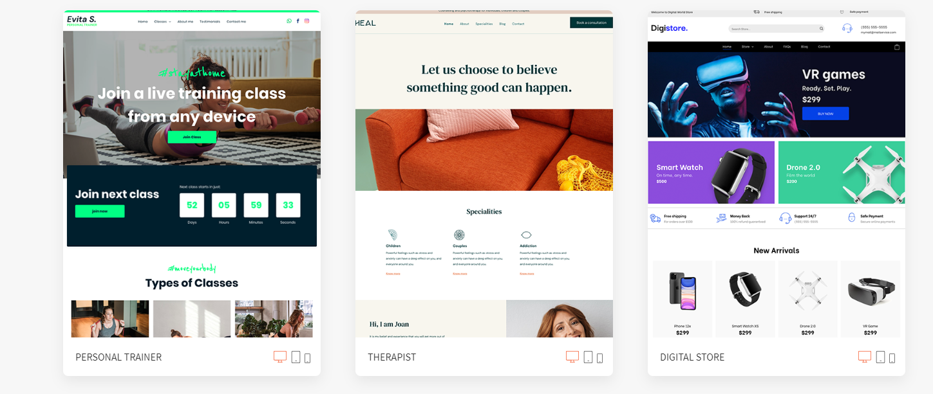
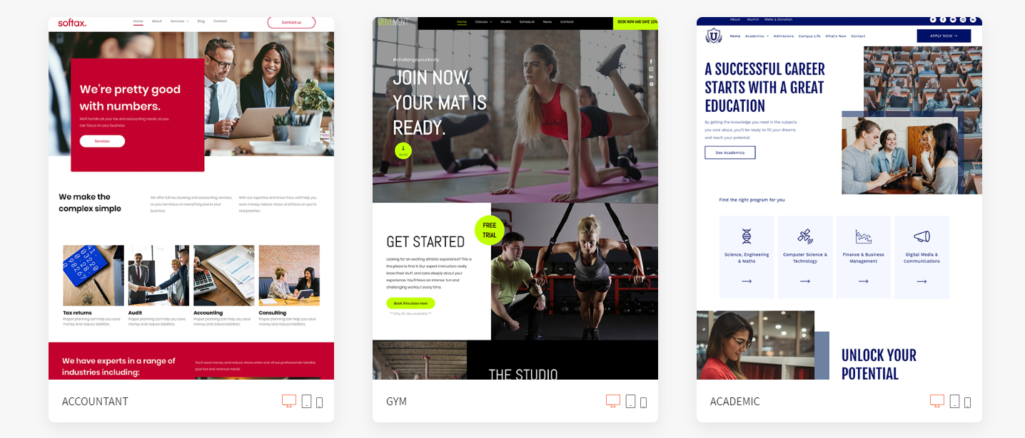
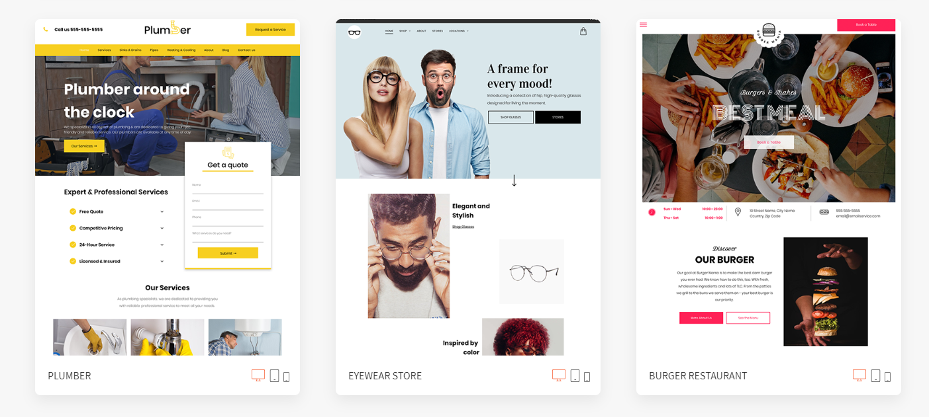
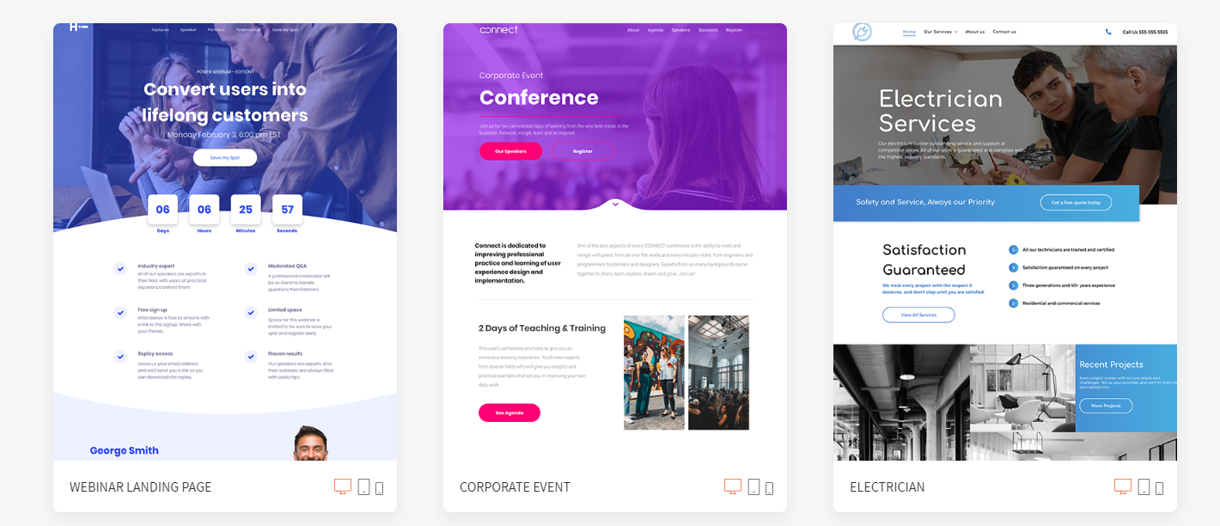
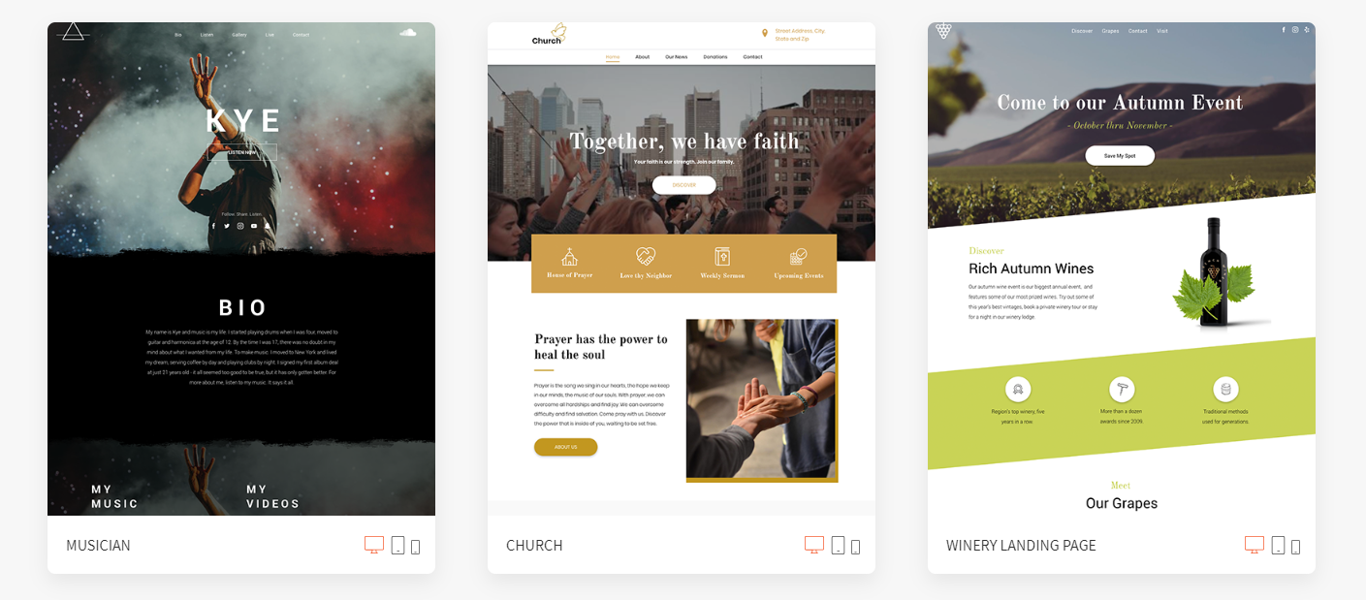
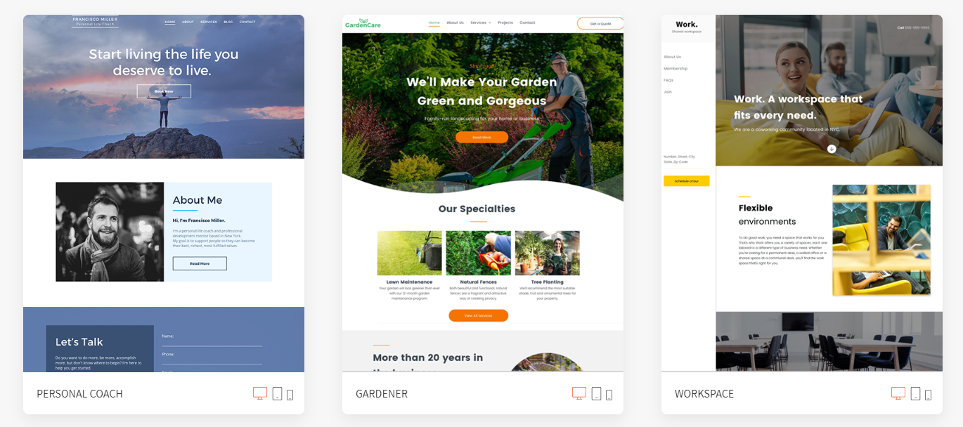

Slide 17
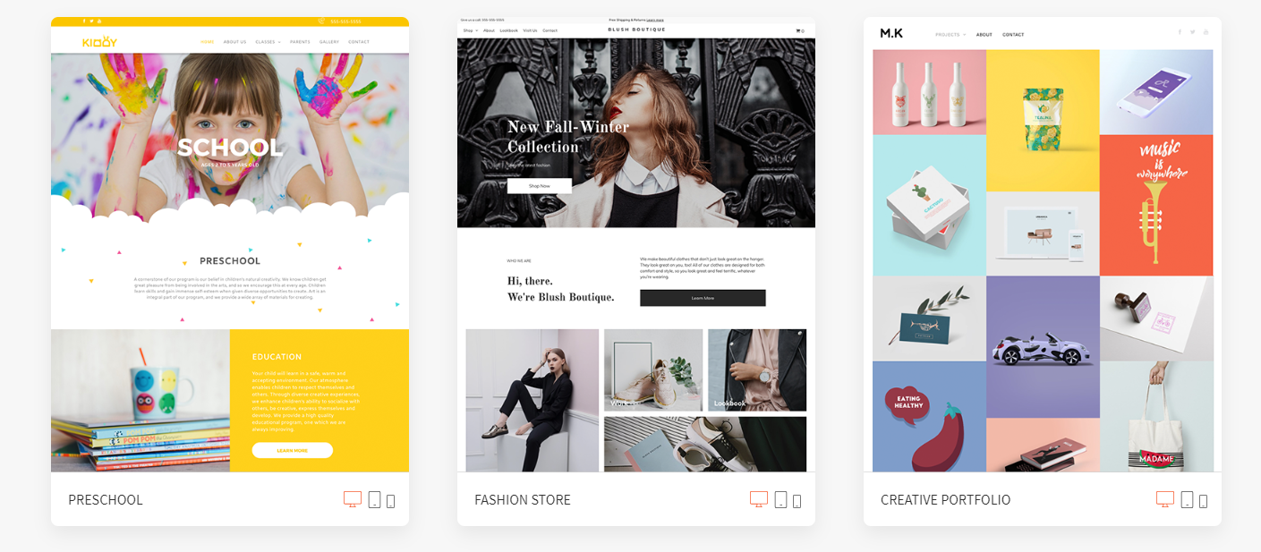
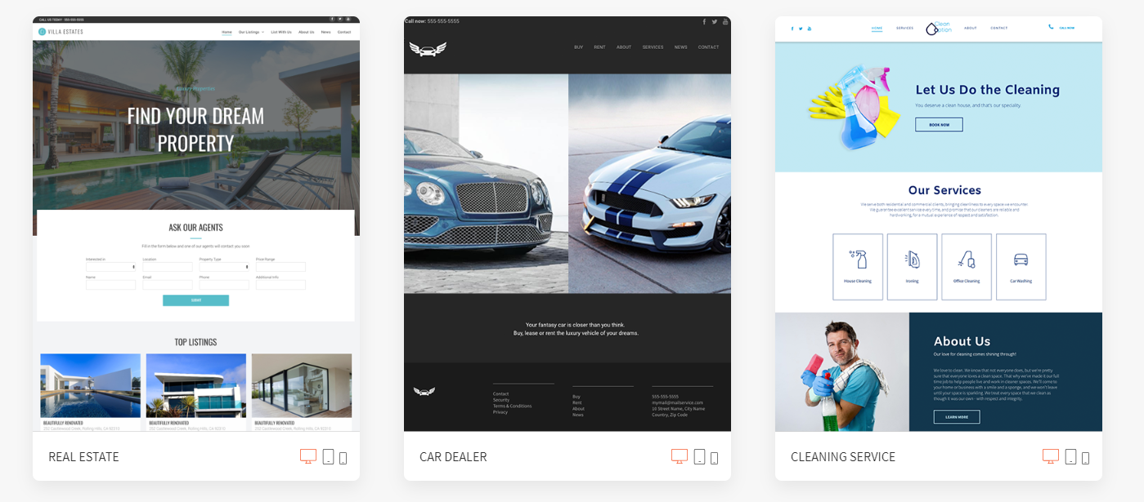
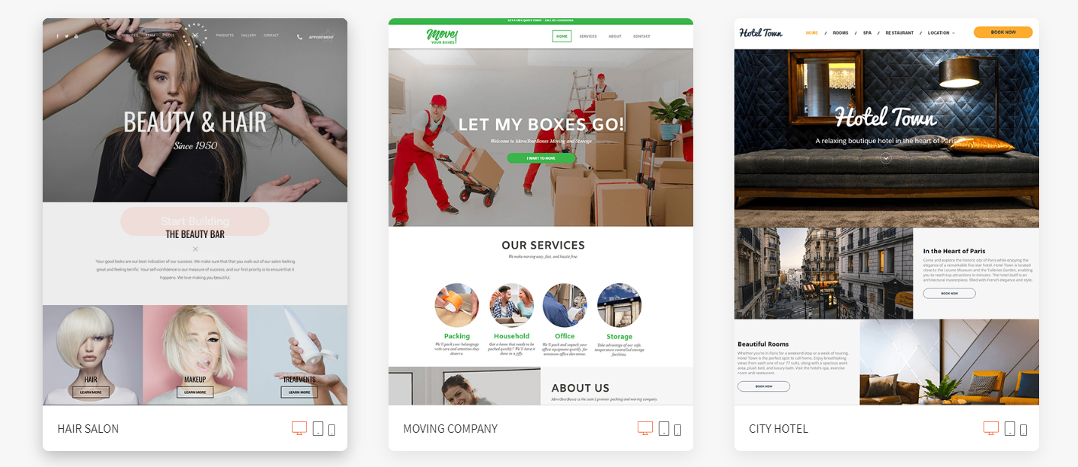
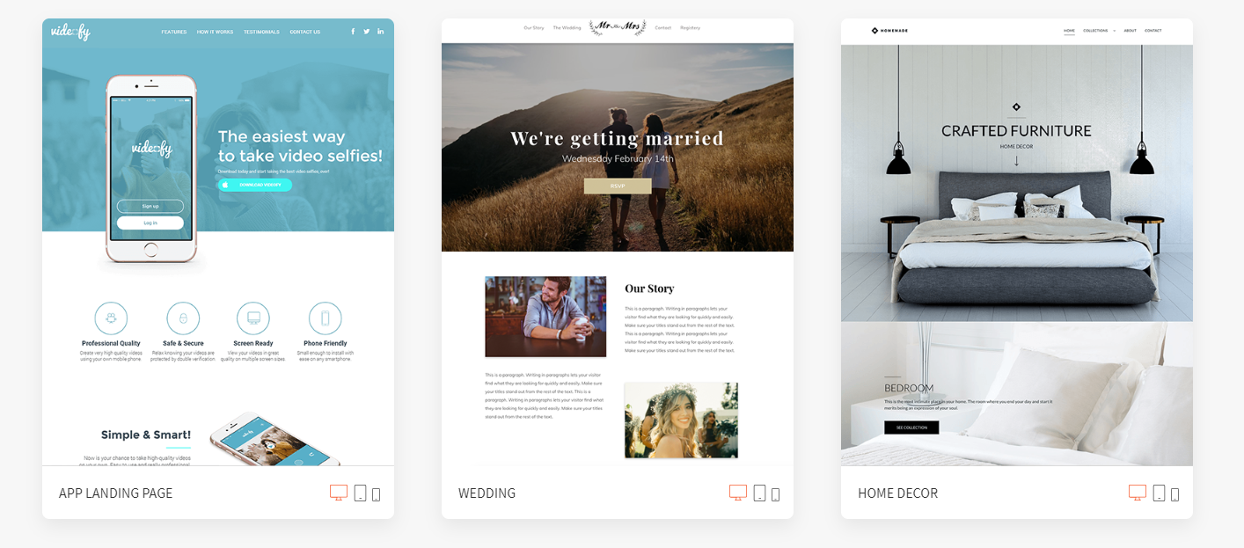
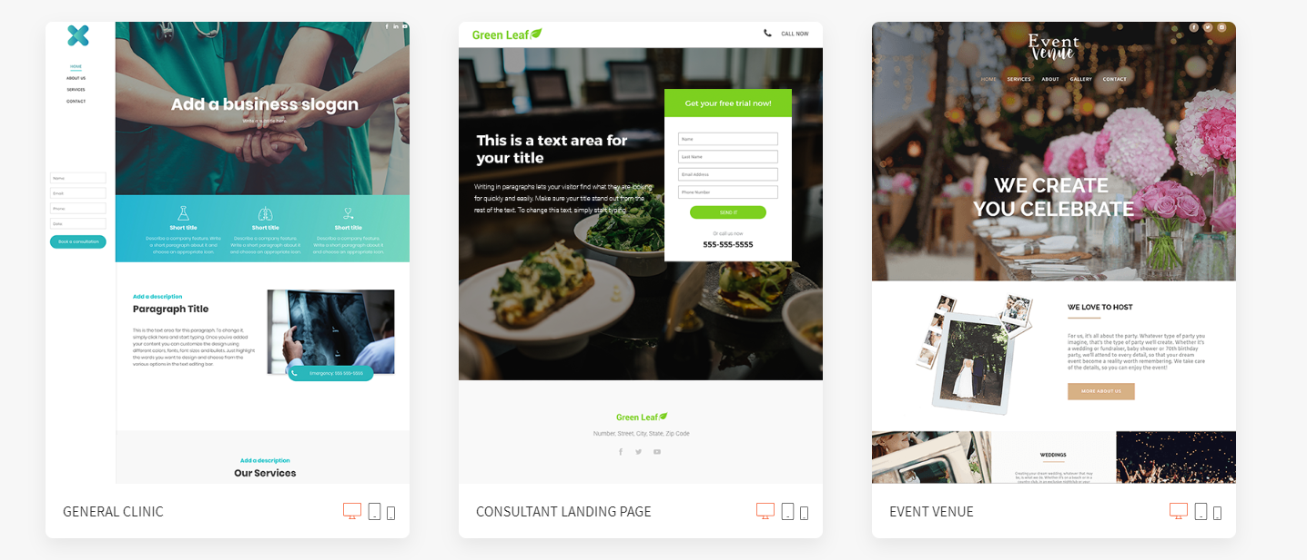
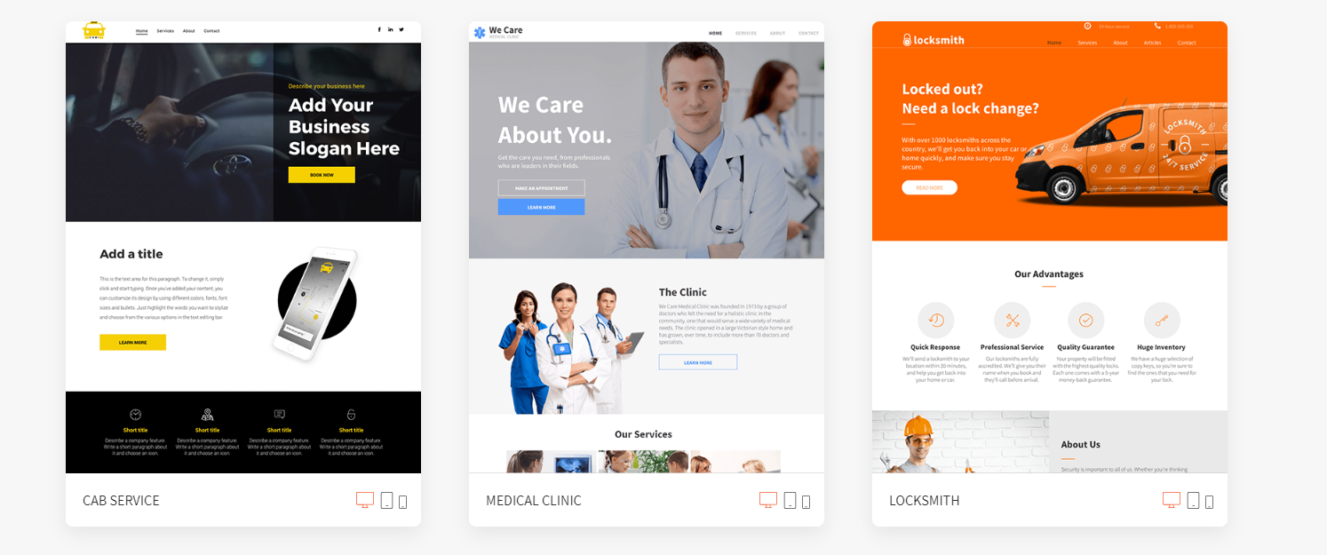

Slide 18
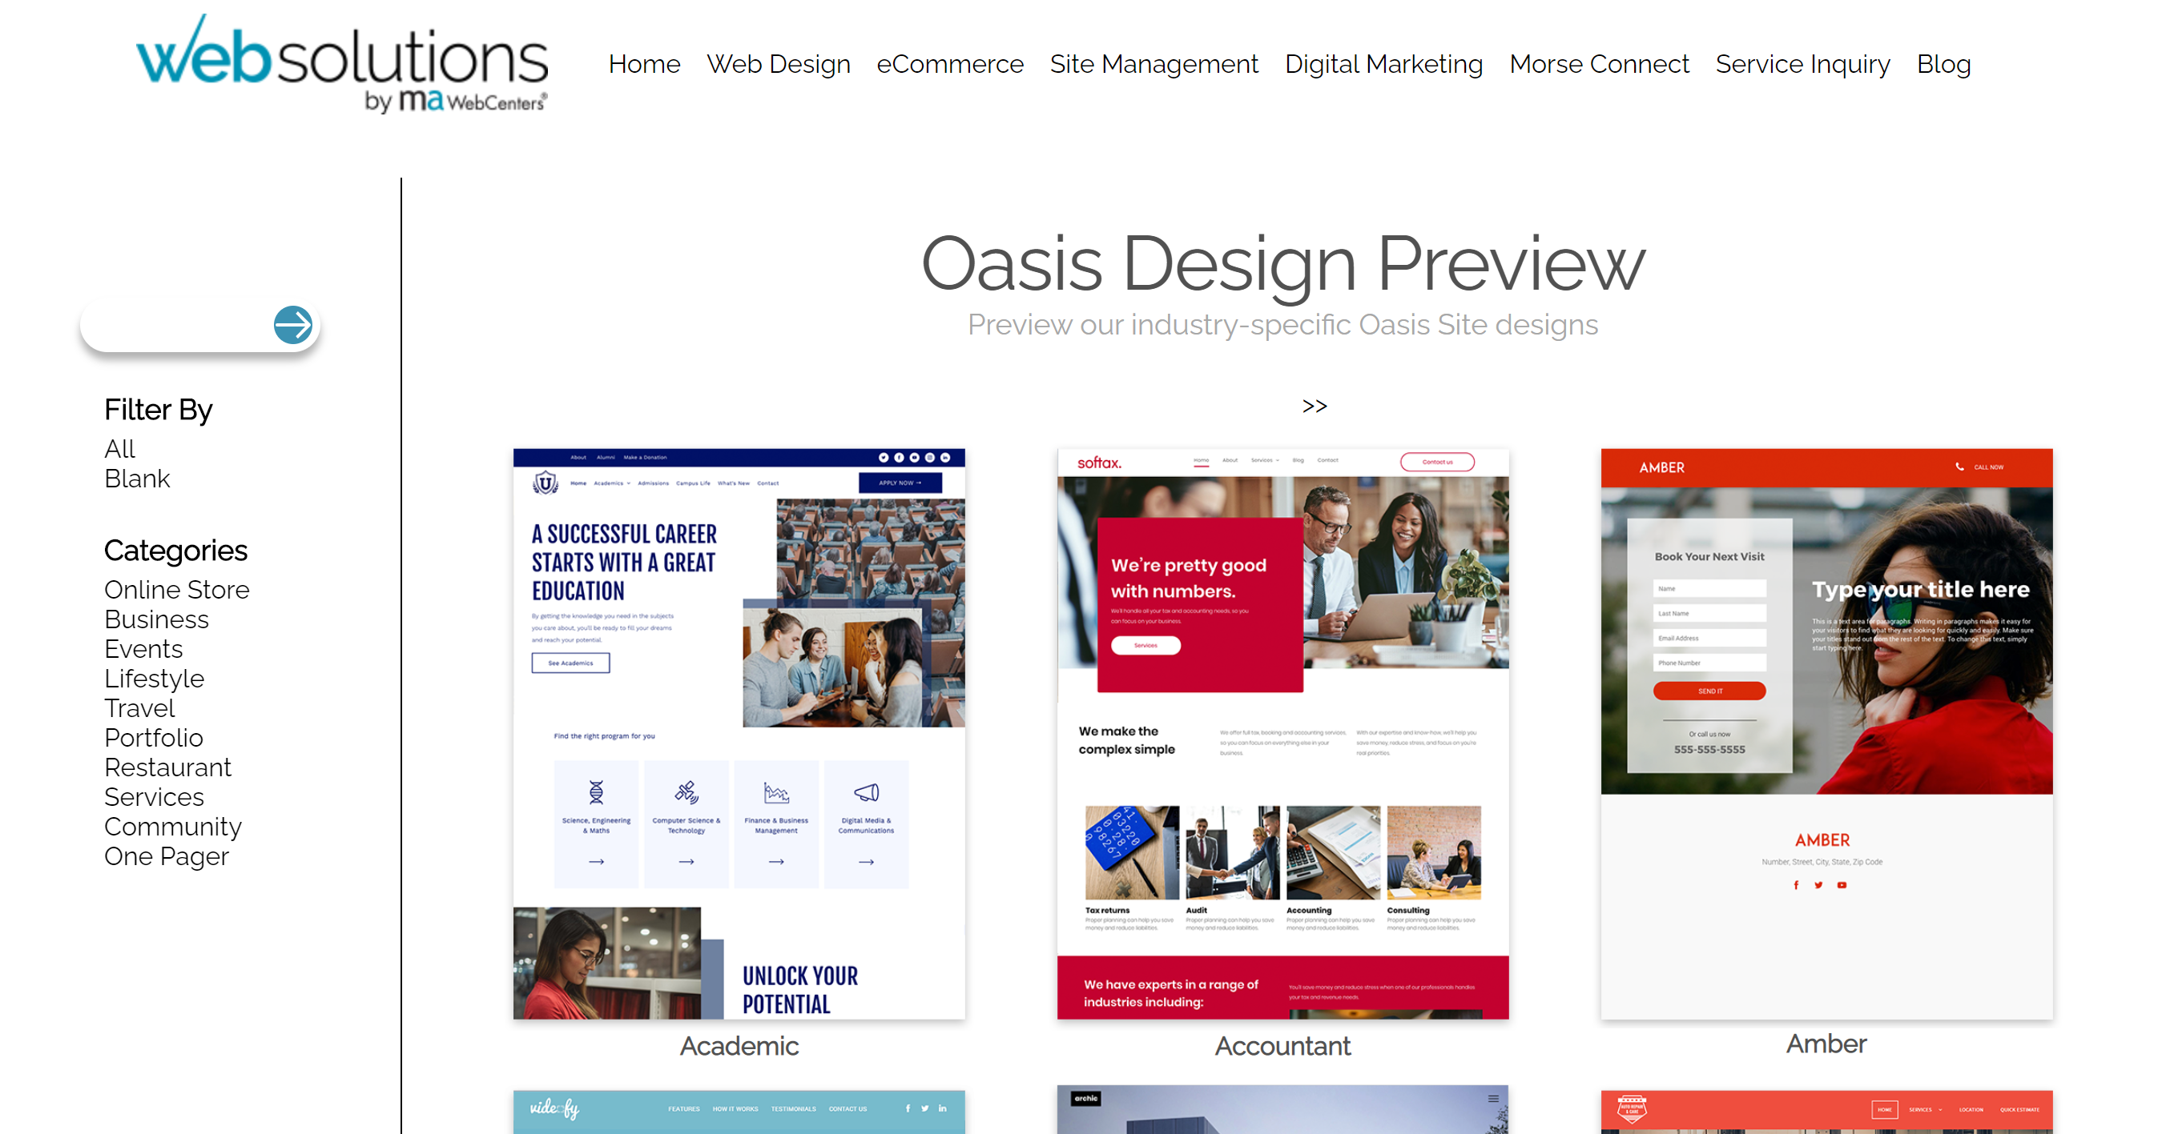
MAWEBCENTERS.COM > Web Design > Oasis

Slide 19
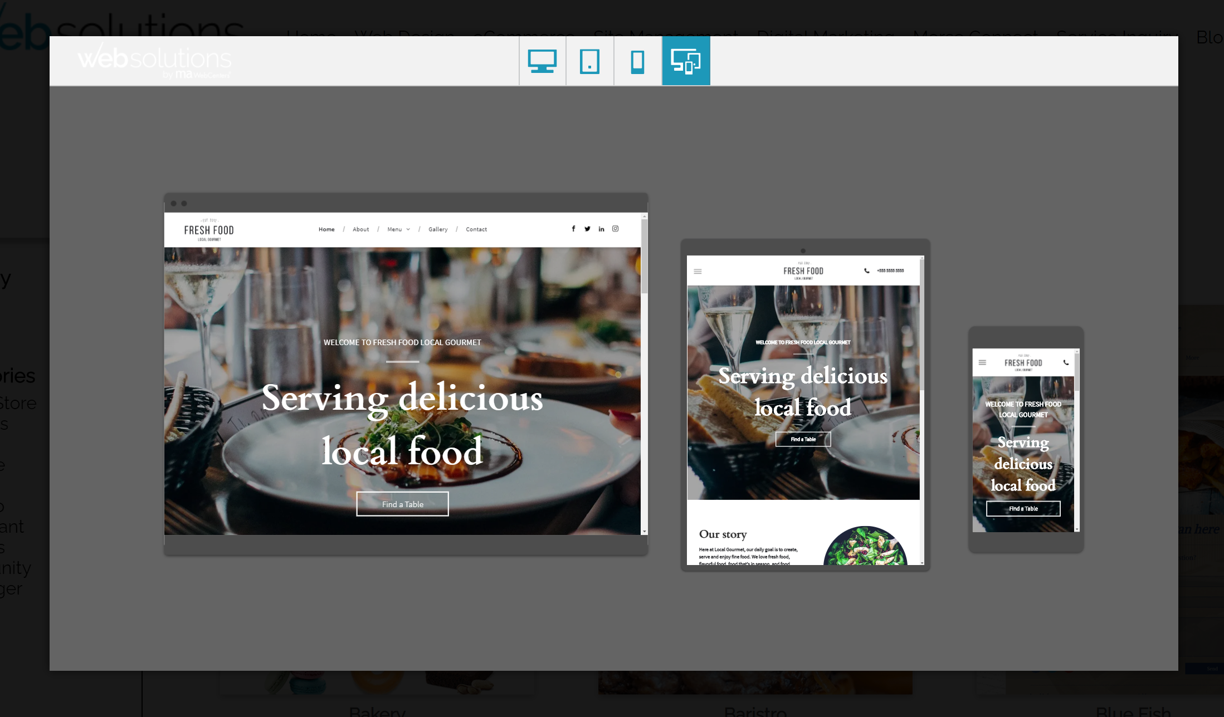
DYNAMIC MUlTI-SCREEN DISPLAY PREVIEW

Slide 20
FEATURES
Oasis’s industry-leading features will exceed expectations.
MANAGING A WEBSITE
With easy-to-use tools, such as the Rich Text Editor, Widgets, and Website Sections, your client can create the site that really represents their brand and company.
ENGINEERED FOR SEO
To make sure our clients’ sites are always right at the top of Google search results, Oasis gives full control of SEO, but applies many settings automatically and seamlessly in the background.
Notes:
TRAINER’S NOTES:
Again – you can apply this to any of your fixed cost goals

Slide 22
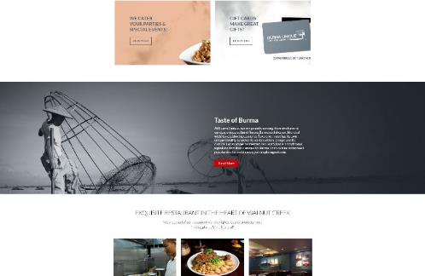
DESIGN CENTER

Slide 23
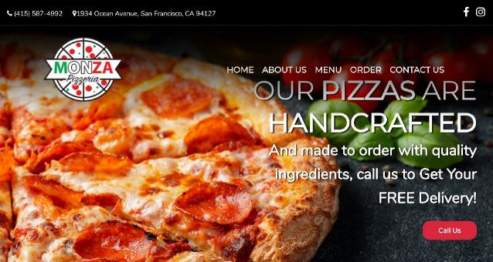
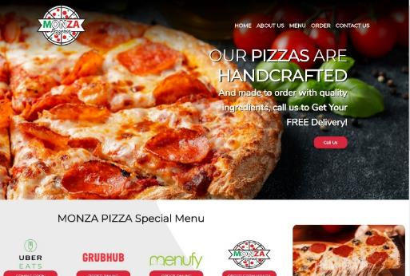
DESIGN CENTER

Slide 24
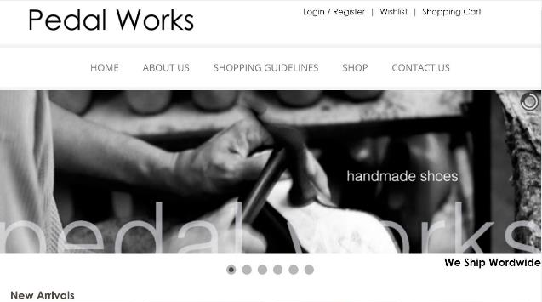
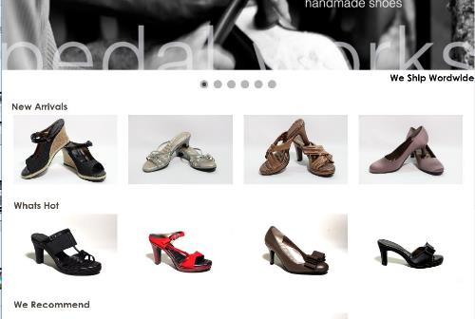
DESIGN CENTER

Slide 25
Our eCommerce Options Help Clients Sell More!

Slide 26
What Sets Our Solution Apart?
Strong SEO for maximum product page visibility in search engines like Google
Easy store management from anywhere with an on-the-go eCommerce editor for Androids & iPhones
Highly integrated with your social media presence
Gorgeous product layouts that encourage customers to click & buy

Slide 27
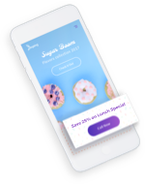
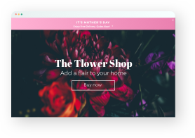
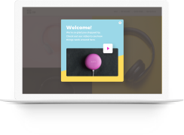
Website Personalization Real-World Examples
Visit Store
Create 1-to-1 Experiences
Trigger: Visitor arrives on site from a mobile device
Action: Save 25% on lunch specials
Value: Visitor comes directly to business
We employ real-time website personalization technology that delivers individualized user experiences based on date, time of day, number of previous visits, visitor geo-location and more!
Order Online
Trigger: Visitor arrives on site on Mother’s Day
Action: Banner promoting free delivery
Value: Visitor has incentive to order flowers
Flash Sale
Trigger: Third time visitor goes to the site
Action: Popup for buy one, get one free
Value: Return visitor is encouraged to buy

Slide 28
DIGITAL MARKETING:
Marketing your business through digital channels
Option 1: TECH SUPPORT
Website clients have access to Tech Support using the tools available.
OPTION 2: SERVICES
Purchase Digital Marketing Products (Can be purchased by existing clients or non-website clients)

Slide 29
SOCIAL MEDIA
Social Media Management, Online Reputation Management, Facebook Advertising
SOCIAL MEDIA
DIGITAL MARKETING
Local SEO, Regional SEO, Google Advertising, Content Writing, Wordpress.org Hosting
TEXT MARKETING & COMMUNICATIONS (US-only)
Landline & Toll-Free Text Marketing Portal
Automated or Real-time Texting Service
WWW.MAWC411.COM
Notes:
TRAINER’S NOTES:
Showcases all of the services that a client can purchase through maWebCenters
The big difference is whether someone will do it themselves, or leverage our teams of experts to do it for them

Slide 30
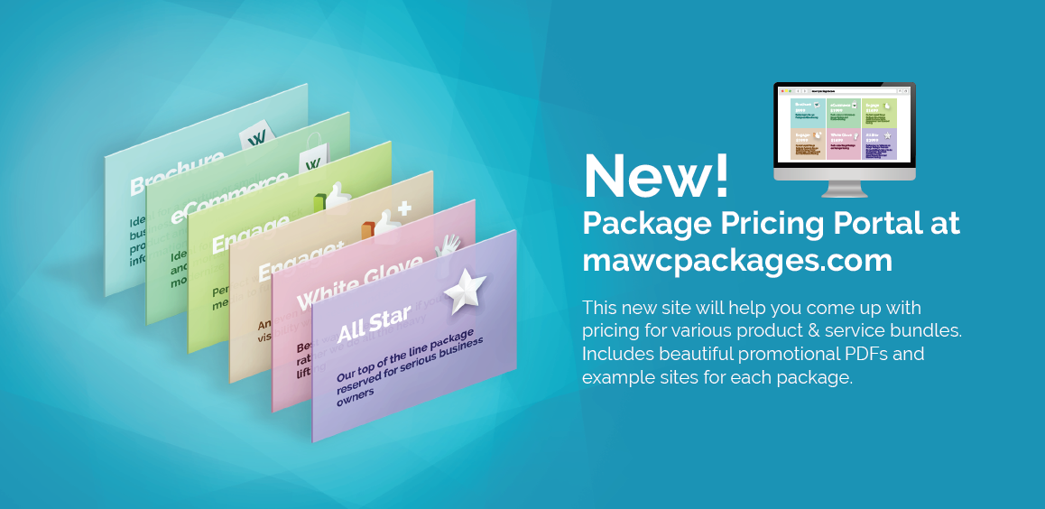

Slide 31
Let’s take a look at earning potential
Retail Profit
BV
Growth Potential
Notes:
TRAINER’S NOTES:
Earning potential will be demonstrated in terms of short term and long term growth potential

Slide 32
Income disclaimer
Earnings depicted are atypical and the success of any UnFranchise® Owner will depend upon the amount of hard work, talent and dedication which he or she devotes to building his or her Market America business. For typical earnings, see market-america.info/mais.

Slide 33
RETAIL PROFIT PER SITE SOLD
USA: $100 - $2,700
CAN, AU, SG: $120 - $3,200
UK: £70 - £1,800
HK: HK$770 - HK$20,700
TW: NT$3200 - NT$32,000
Divide your short term goal by your average retail profit to determine how many sales it will take to reach your goal.
For example: A USA WCO has $5,000.00 in debt divided by $1,000.00 in retail profit = 5.
Therefore, just 5 new sales could pay for the initial goal of $5,000 USD.
Short term goals can be met with retail profits
Notes:
TRAINER’S NOTES:
Again – you can apply this to any of your fixed cost goals

Slide 34
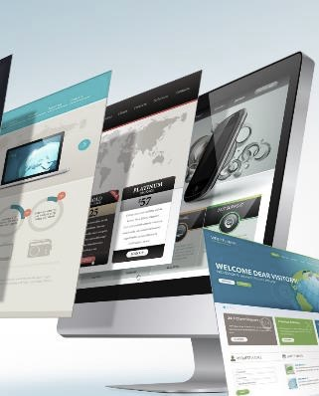
Each website sold
generates UP TO 235 BV
Each active client
generates
5, 30, or 40 BV / Mo.
DIGITAL MARKETING PRODUCTS GENERATE ADDITIONAL BV AND RETAIL PROFITS
Notes:
TRAINER’S NOTES:
Long Term Potential for WCOS = Ongoing BV and Retail Profits

Slide 35
Build share of customer
ITEM | RETAIL PROFIT | BV
WEBSITE SALE | $1,000 | 200 BV 30/ MO.
LOCAL SEO | $26 | 75
SOCIAL MEDIA MANAGEMENT | $15/ MO. | 20 BV/ MO.
PREMIUM FACEBOOK ADVERTISING | $10/ MO. | 15 BV/ MO.
BASIC GOOGLE ADVERTISING | $24/ MO. | 24 BV/ MO.
TOTAL INITIAL SALE | $1,075 | 364 BV
TOTAL RECURRING | $49/ MO. | 89 BV/ MO.
Your client buys a website
AND wants to market the site
YOU CAN START WITH A WEBSITE SALE OR A DIGITAL MARKETING PRODUCT SALE.
GROW THE RELATIONSHIP TO BUILD SHARE OF CUSTOMER.
Notes:
TRAINER’S NOTES:
Take a look at what the Digital Marketing Products generate
Remember, full pricing and BV is available on mawc411.com/support.html

Slide 36
THE PROVEN SYSTEM IS BUILT ON SELLING APPOINTMENTS,
THEN LEVERAGING OUR TEAMS OF PROFESSIONALS TO DO THE HEAVY LIFTING
THINK OF IT AS A “REFERRAL APPROACH”
SIMPLE & EFFECTIVE
Notes:
TRAINER’S NOTES:
You are not the sales, design or technical expert
There are professional teams that work for you who will do this heavy lifting for you
The simple sales system works best for WebCenter owners who are not industry professionals because it doesn't’t require the UFO to be the expert. They simply make the “referrals” to the prospect to schedule and appointment with the expert. The expert takes it from there.
Because this is a “natural” way to get started, you can get started now and have success quickly

Slide 37
AS A REMINDER…
Teams of Professionals include:
Product Specialists
DESIGN & DIGITAL TEAMS
Customer Care
Notes:
TRAINER’S NOTES:
You are not the sales, design or technical expert
There are professional teams that work for you who will do this heavy lifting for you

Slide 38
Proven system for success
YOU TALK WITH BUSINESS OWNERS AND SET AN APPT.
SALES TEAM
DESIGN, DIGITAL, SUPPORT TEAMS
CLIENT GETS A GREAT SITE AND SUPPORT MARKETING IT
Notes:
TRAINER’S NOTES:
1 minute
Shows the simple sales system.

Slide 39
THE WEBCENTER PROGRAM CAN WORK FOR ANYONE! CHOOSE THE PROGRAM THAT FITS YOUR BACKGROUND.
OUR SYSTEM IS BUILT ON TALKING TO BUSINESS OWNERS AND THEN LEVERAGING TEAMS OF PROFESSIONALS.
WHAT QUALITIES MAKE A GREAT WEBCENTER OWNER CANDIDATE?
FRIENDLY. MOTIVATED. SELF DRIVEN. ORGANIZED. WELL CONNECTED.
SOCIAL. UFO PROSPECTS.
Notes:
TRAINER’S NOTES:
When identifying great WCO candidates, it’s important to focus on the “kind of person” the prospect is rather than their just their profession
Techies are not bad candidates. They simply aren’t the ONLY candidates
A waitress who is a go getter/ motivated individual is a better WCO candidate than a lazy web designer AND VICE VERSA
We have programs built for average people and programs built for Pros – in both cases, the qualities of the candidate is critical

Slide 40
WEBCENTER PROGRAM
Who is this program for? ANYONE
WebCenter Owners have access to sell the line of WebCenter products, WebCenter Program Benefits and Teams of Professionals.
SOCIAL MEDIA
WEBCENTER PRO PROGRAM Fully customizable website, Co-branded storefronts, invoicing and admin, Ability to create and store layouts in the library, VIP Technical Support, Pro Education Series.
Pro Affiliate: Industry Pros with light access to the UnFranchise Business, income potential of $1,500/week.
Pro Partner: Industry Pros or WCOs who have sold over 20 websites w/ FULL access to the UnFranchise Business with unlimited income potential with up to $3,600 per Business Development Center.
Notes:
TRAINER’S NOTES:
Understand the different programs which exist for folks who would be interested in leveraging our system

Slide 41
We’ve established
We have an incredible product that is a profitable investment for your client!
There is solid earning and growth potential for you, the WebCenter Owner
Let’s take a look at what’s included in the system behind the product and potential!
Notes:
Trainers Notes:
Again – another Impact Slide! Just a reminder – “We have an awesome product and there is a market place for what we are selling”.
Now we transition into the next point of evaluation – “the system”

Slide 42
Your WebCenter provides you with all of the tools you need to leverage our proven system for success
Customer relationship management, search engine tools, social media tools, mobile websites and more!
Sales Support, Design Center, SPECIAL TEAMS, Customer Care, and STANDARDIZED WEBCENTER TRAINING
A front-end website to market your website sales business
Access to domains, emails AND email marketing
An interactive sales calendar to schedule appointments
Notes:
TRAINER’S NOTES:
30 seconds
Quick slide to acknowledge the marketplace and opportunity to do business in this industry is BOOMING.

Slide 43
www.mawc411.com
Notes:
TRAINER’S NOTES:
www.mawc411.com – WebCenter Owner’s support site. This is the great place to share the WebCenter opportunity with potential business partners who could major in WebCenters, launch your business, find training learn more about our teams, and connect with our community
The downloads page is the most frequented page and houses many downloads including the ones we are about to showcase

Slide 44
SALES AIDS AND MARKETING TOOLS
Marketing Manual
B2B Catalog
Features & Benefits Guide
Notes:
TRAINER’S NOTES:
This in between step will help you to truly determine someone’s specific needs, set more quality appointments with product specialists and demonstrate interest in your candidates which sets the tone for more quality relationships
Explain the two main consult sheets , how to choose which one makes the most sense to conduct

Slide 45
INTERNET SALES & MARKETING TRAINING SERIES
WEBCENTER CERTIFICATION TRAINING 101
SUCCEEDING WITH WEBSOLUTIONS
INTERACTIVE TRAINING & WORKSHOPS
GOAL-SETTING ◆ 5C’S WORKSHOP
Check your GMTSS in all Regions for the next in-person or online training.

Slide 46
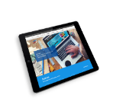
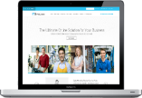
YOUR OPTIONS
Proven system for success
WEBCENTER INTERN
LEARN THE PROCESS w/ a CURRENT WCO
LEVERAGE THE PROFESSIONALS
EARN RETAIL PROFIT TO LAUNCH YOUR WEBCENTER
WEBCENTER FAST START
LAUNCH YOUR UNFRANCHISE
WITH THE WEBCENTER FAST START KIT
PURCHASE WEBCENTER CODE #6040 $100.00 USD 50BV
REACTIVATE WEBCENTER CODE #6040RA $150.00 USD NO BV
Notes:
TRAINER’S NOTES:
Briefly cover the options to get started as a WebCenter Owner

Slide 47
The Product & Service All-inclusive, superior online marketing solution to help businesses market their business
Profitability Substantial retail profit & BV potential with opportunities to domestically & globally
The System A simple sales system, supported by teams of professionals
Support Standardized trainings, webinars, printed materials, teams of professionals
How to Get Started Fast Start Kit, Become a WebCenter Owner, Internship
Let’s go ahead and re-ask those important questions!
Notes:
TRAINER’S NOTES:
Revisits the initial questions we wanted to answer for the person evaluating this as a business opportunity
Impact slide – hit the points hard but quickly

Slide 48
YOUR NEXT STEPS
GET YOUR QUESTIONS ANSWERED Register for webinars and review www.mawc411.com
BOOK A FOLLOW-UP Schedule an appointment to get your questions answered and learn about the UnFranchise
ESTABLISH YOUR WEBCENTER Purchase your WebCenter or Register your UnFranchise with the WebCenter Fast Start Kit
Notes:
TRAINER’S NOTES:
Self explanatory

Slide 49
INTERNET SALES & MARKETING TRAINING SERIES
WEBCENTER CERTIFICATION TRAINING 101
SUCCEEDING WITH WEBSOLUTIONS
Trainer Name
INTERACTIVE TRAINING & WORKSHOPS
GOAL-SETTING ◆ 5C’S WORKSHOP
Internet Sales & Marketing Trainer
Short Bio
Bullet point
Bullet point
Bullet point
Bullet point
Location: City, State
Cost: $25
To Register:

